Slide 1
Python

Slide 2
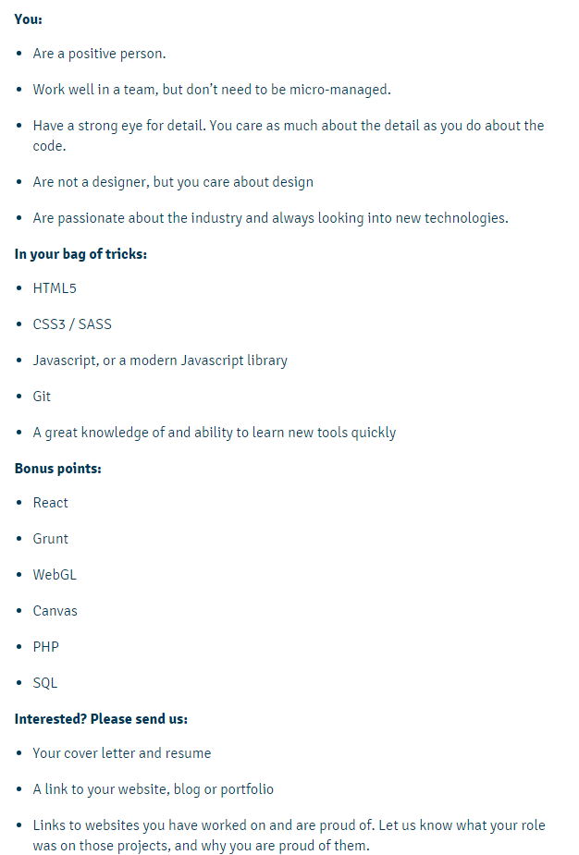
Job opportunity in Dunedin!
https://thebold.nz
https://thebold.nz/blog/read/web-developer-new-position-available/

Slide 3
Intro
Python is a general-purpose interpreted, interactive, object-oriented, and high-level programming language.
It was created by Guido van Rossum during 1985- 1990.
Python source code is also available under the GNU General Public License (GPL).
Python standard library is very portable and cross-platform compatible on UNIX, Windows, and Macintosh.
Python Official Website : http://www.python.org/

Slide 4
Overview
Python is Interpreted: Python is processed at runtime by the interpreter. You do not need to compile your program before executing it.
Python is Interactive: You can actually sit at a Python prompt and interact with the interpreter directly to write your programs.
Python is Object-Oriented: Python supports Object-Oriented style or technique of programming that encapsulates code within objects.

Slide 5
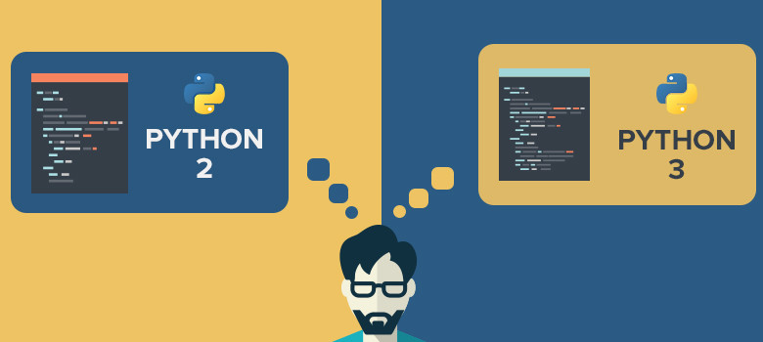
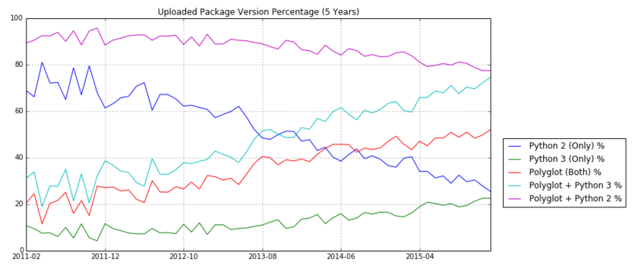
Python Big Fork
Take-home message: Uploaded Packages are increasingly containing Python 3 Support and decreasingly containing Python 2 support.

Slide 6
Installing Python
For any Python installation, I strongly recommend that you use Python versions 3.x
You have 2 options:
Install the basic Python interpreter
https://www.python.org/downloads/
(my recommendation for you) Install a bundle of Python interpreter and numerous useful/popular modules
I recommend the Anaconda distribution
https://www.continuum.io/downloads

Slide 7
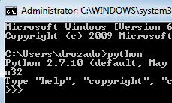
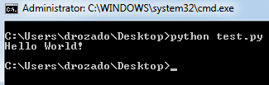
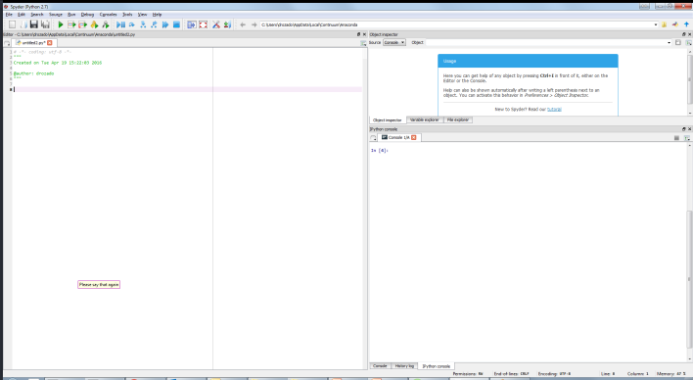
Running Python
Interactive Interpreter
Script executed from the command line
Integrated development environment (IDE)

